Slide 1
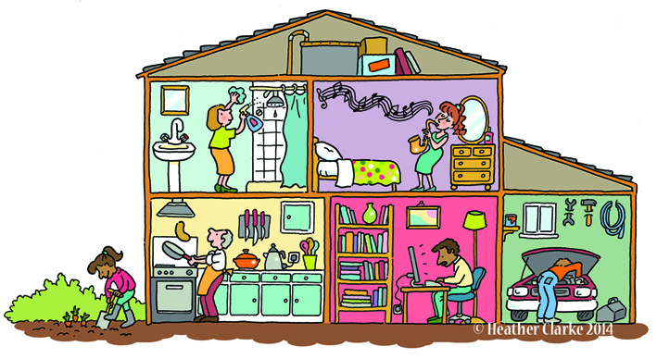
Rooms around the house

Slide 2

Parts of the House

Slide 3
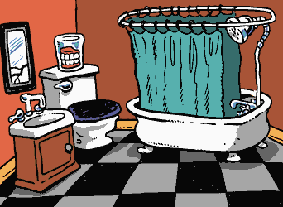
a room with a bath
bathroom

Slide 4
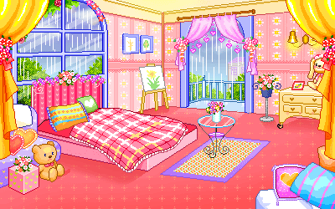
a room with a bed
bedroom

Slide 5
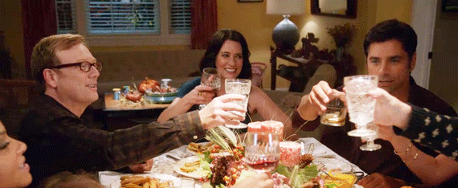
a room where we can have dinner
dinner
dining
sounds alike
dining room

Slide 6
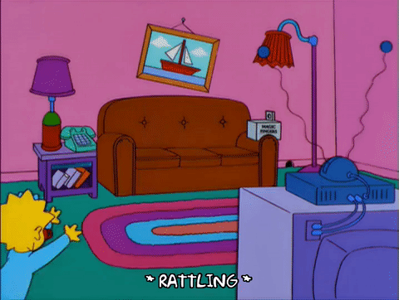
a room where we can live
living room

Slide 7

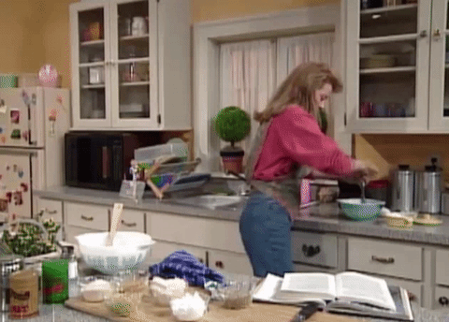
a room where we can cook
chicken
kitchen

Slide 8
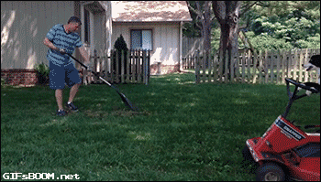
a place where we play and plant
yard

Slide 9
1
2
3
4
5
6

Slide 10


Slide 11


Challenge Time!!!!!

Slide 12
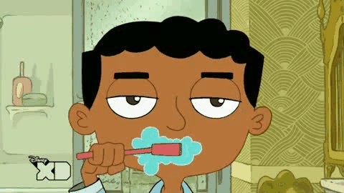
Q1. Where in the house do you brush your teeth?

Slide 13
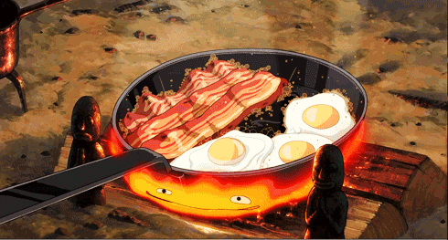
Q2. Where in the house do you cook food?

Slide 14

Q3. Where in the house do you sleep at night?

Slide 15
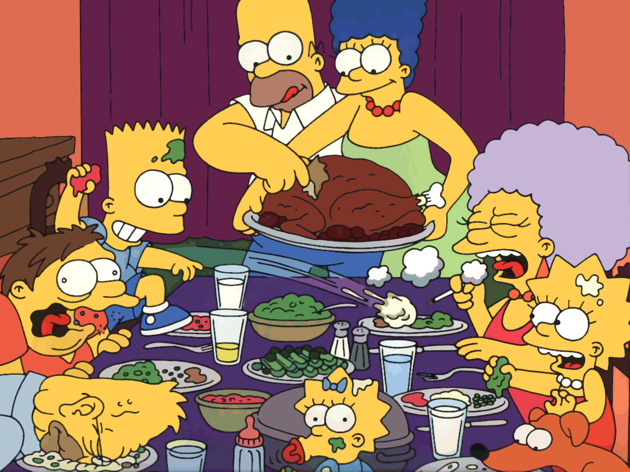
Q4. Where in the house do you eat dinner?

Slide 16
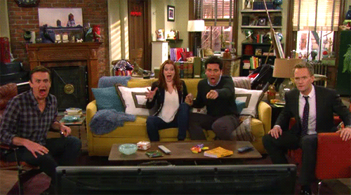
Q5. Where in the house do you sit with your family and watch TV?

Slide 17
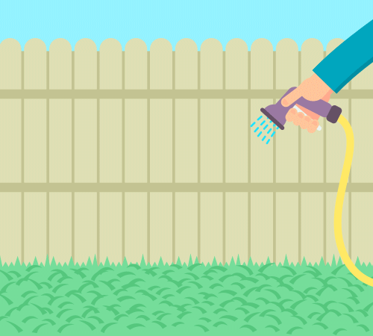
Q6. Where do you see grass?

Slide 18


Harder Challenge!!!!!

Slide 19
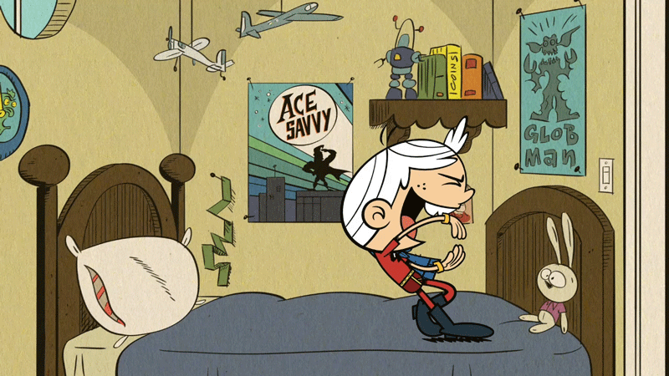
Q7. Where are your books, toys and games?

Slide 20
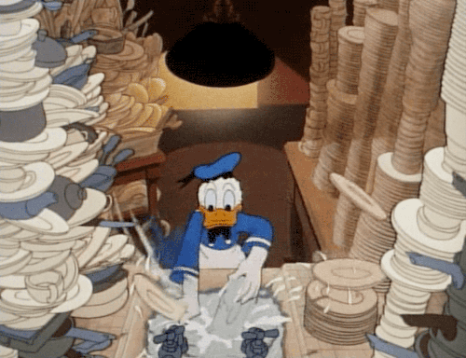
Q8. Where are the dishes washed?

Slide 21


Q9. Where can you plant the flowers?

Slide 22
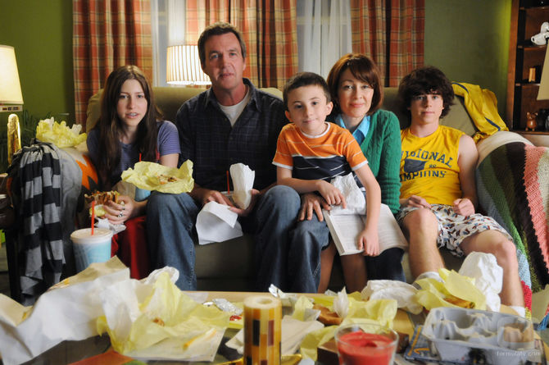
Q10. Where does your family relax together?

Slide 23

Q11. Where can you get wet inside your house?

Slide 24
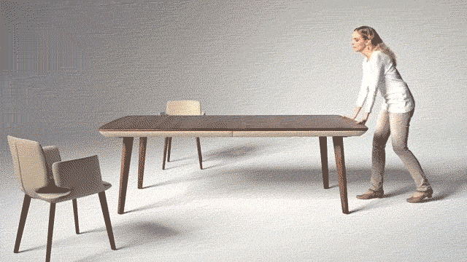
Q12. Where is the largest table for eating?

